Slide 1
SORTING ALGORITHM -Object Oriented Programming- Topic 4: Sorting algorithm on array(2)
GROUP 10
Ngô Duy Đạt -20225480-
Phạm Đặng Tấn Dũng -20225569-

Slide 2

Problem Overview
Requirement
Libraries
We will make an application to display the sorting process of three sorting algorithms: Bubble Sort, Insertion Sort and Quick Sort.
JavaFX is used to implement visualization in ourr project.
Techniques
OOP techniques as Polymorpishm, Inheritance, Encapsulation, Abstraction are utilized through steps of code in Java language.

Slide 3
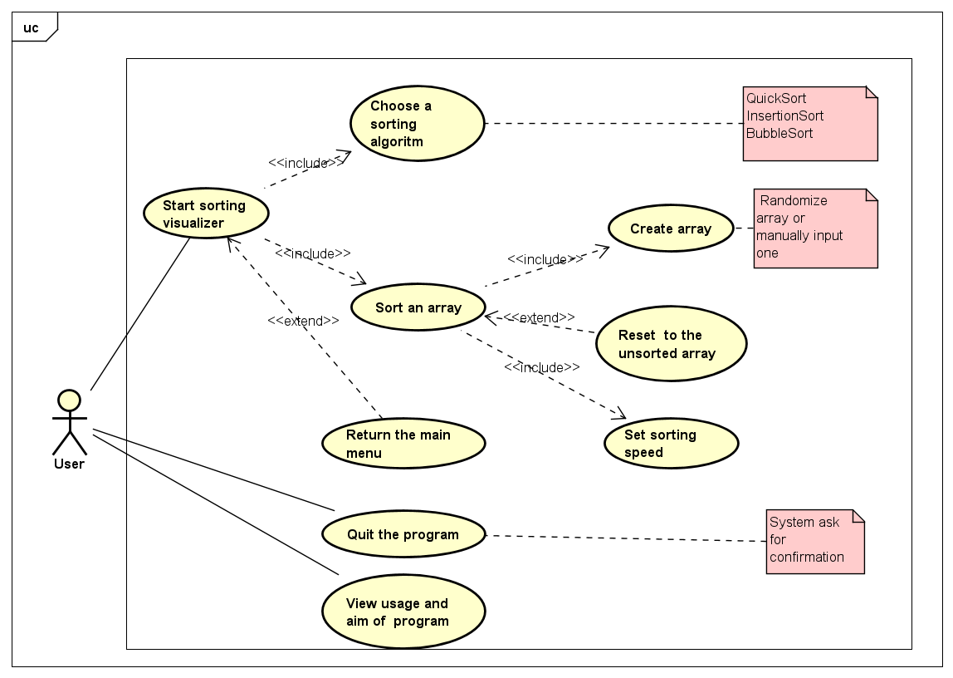
Usecase Diagram

Slide 4
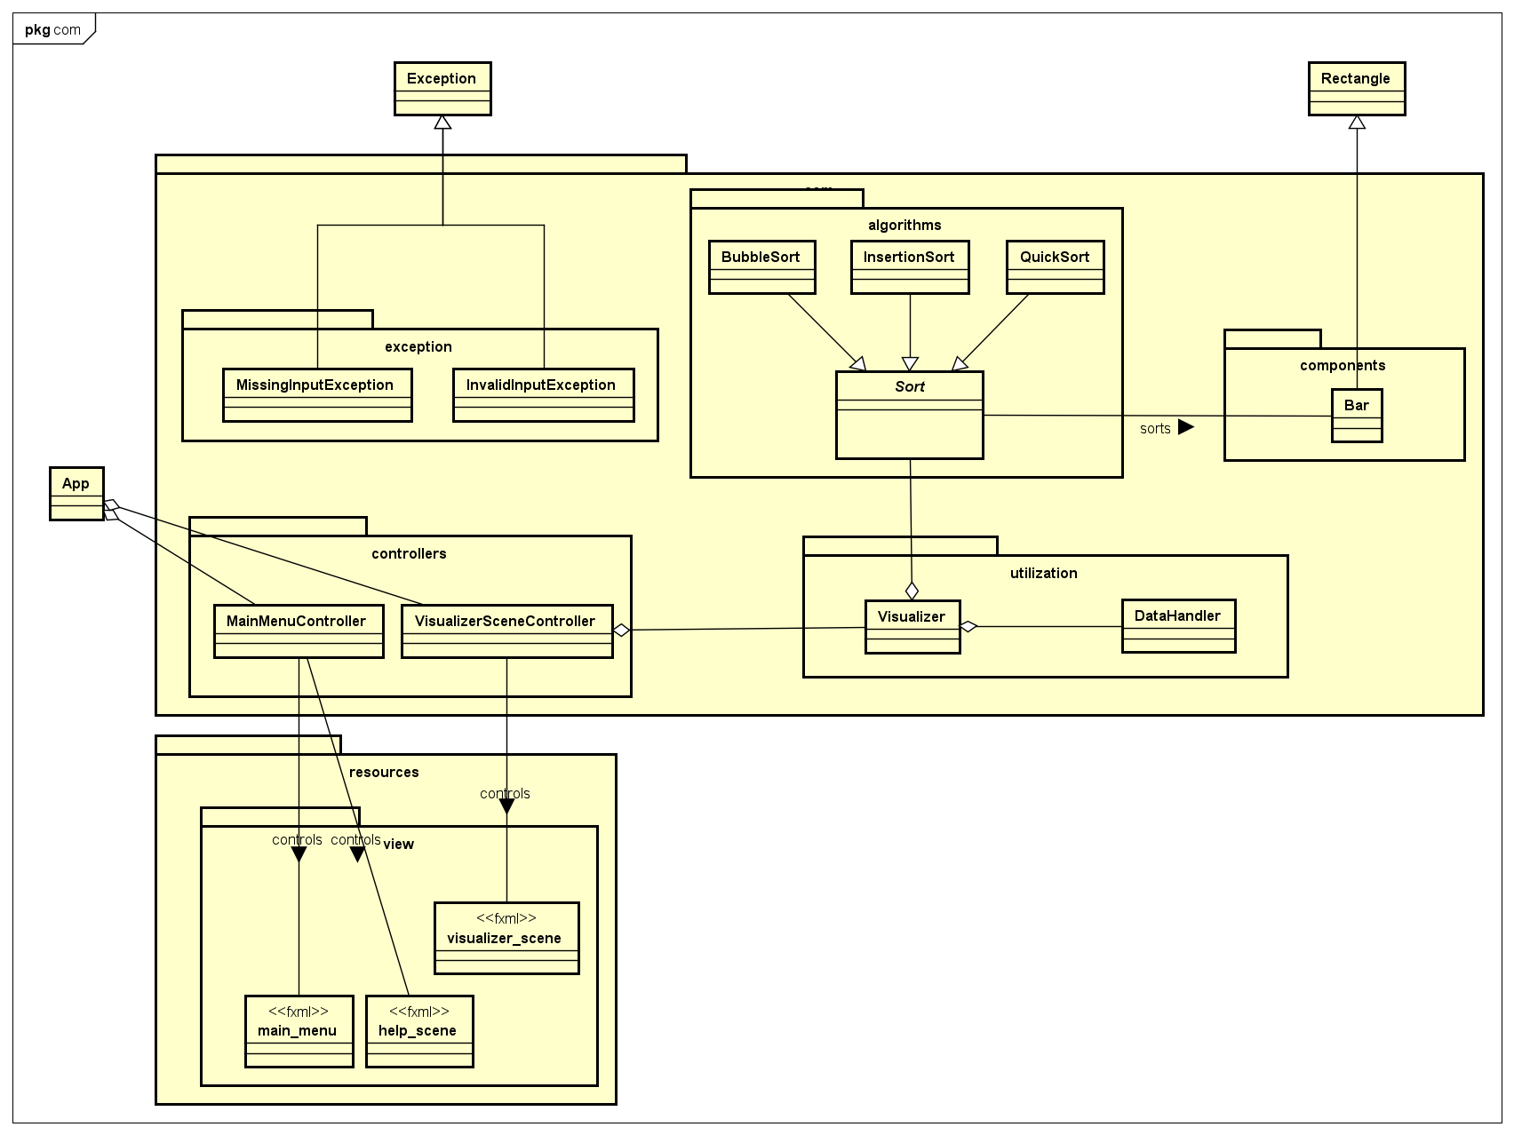
General Class Diagram

Slide 5
Sorting Visualizer Flow
Users insert data or randomize data on the UI
Visualizer uses its DataHandler to create an integer array or throw Exceptions if there is invalid input
Visualizer creates an array of Bars from the integer array
A Sorting Animation is played on the UI
Visualizer uses its Sort to sort the array of Bars
User can change the speed of animation here
User can choose the type of Sort and Visualizer will casts its Sort to that type

Slide 6
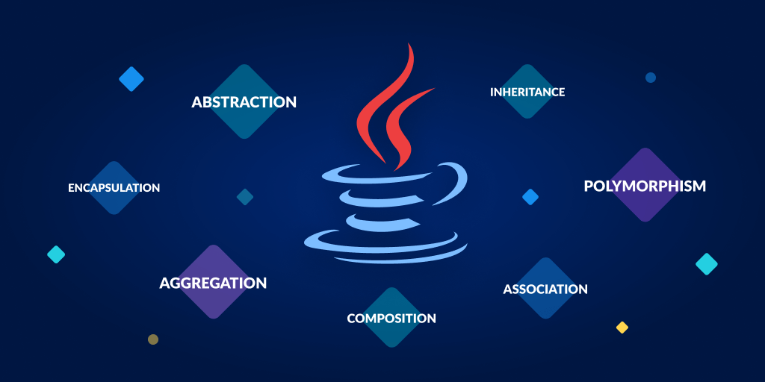

Detailed Class Diagram

Slide 7
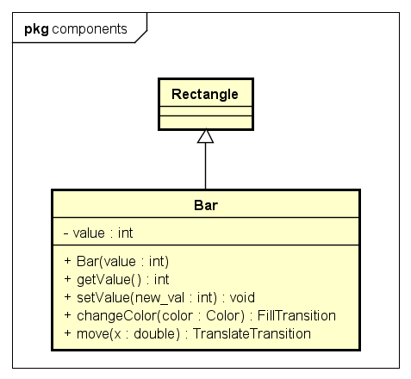
Bar Class

Slide 8
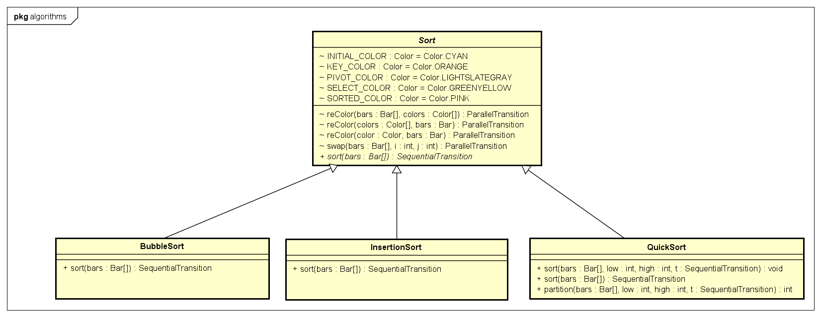
Package main.com.algorithms

Slide 9
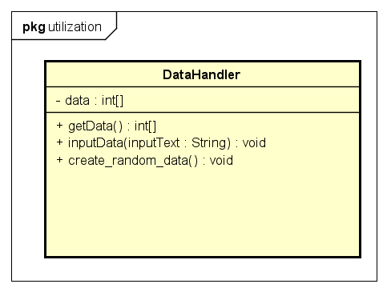
DataHandler Class

Slide 10
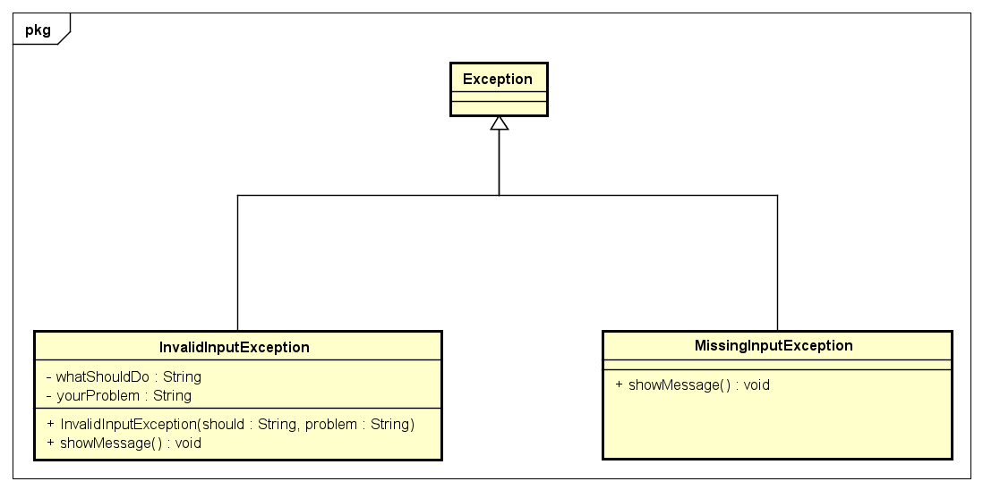
Package main.com.exceptions

Slide 11
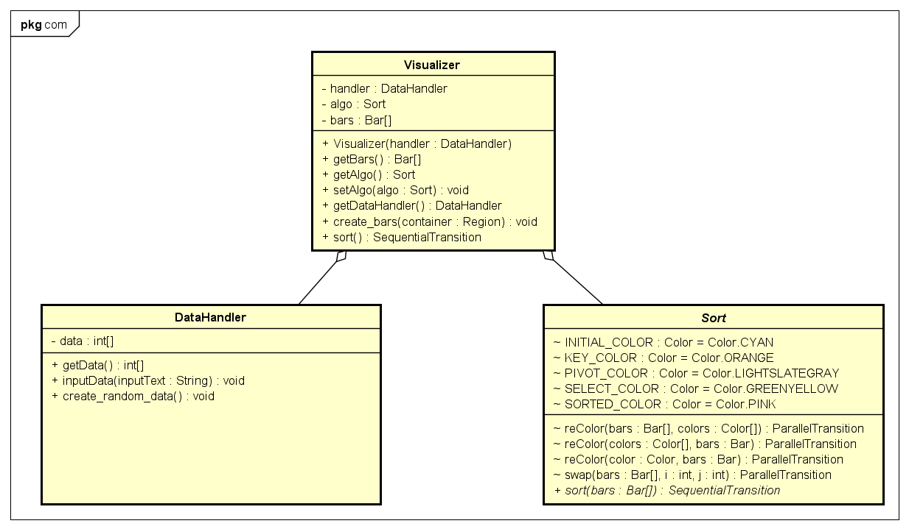
Visualizer Class

Slide 12
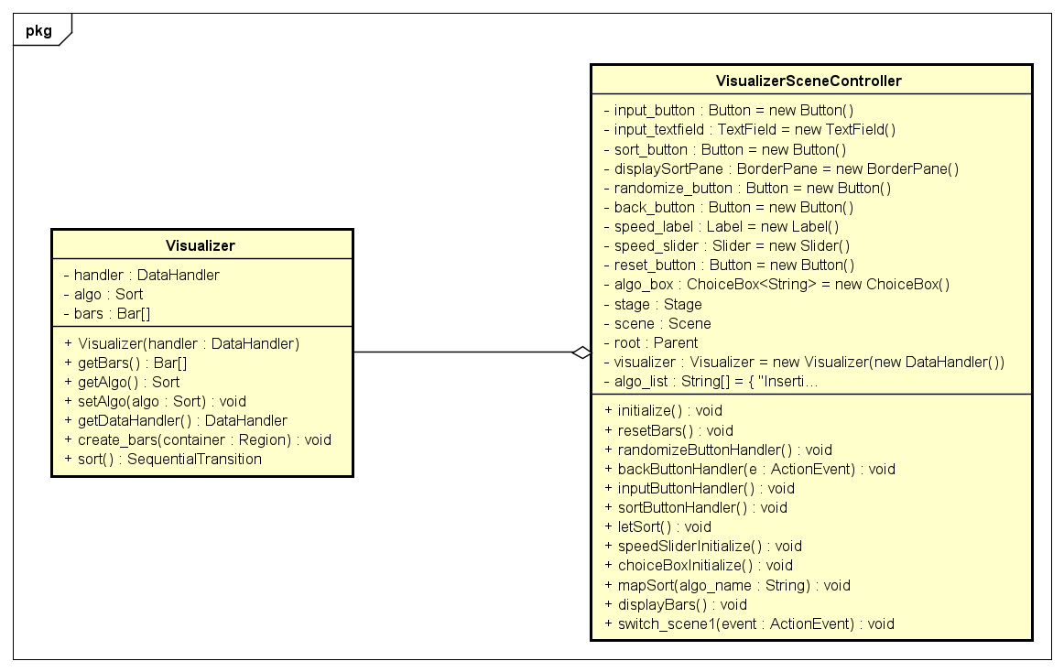
VisualizerSceneController Class

Slide 13

OOP Techniques
01
04
02
05
03
06
Inheritance
Abstraction
Polymorphism
Association
Encapsulation
Aggregation

Slide 14

Inheritance
Inheritance is a common technique used in OOP and this is how it is used in our project:
All sorting algorithms inherit from abstract class Sort
Class Bar is inherited from Rectangle
Inheritance is used with Exception to prevent unallowed attempt

Slide 15

Polymorphism
Polymorphism is a common technique used in OOP and this is how it is used in our project:
Method sort is overrided in children classes
Some methods are overloaded for readability and flexibility

Slide 16

Association
Association is a common technique to describe relationships among classes and this is how it is used in our project:
VisualizerSceneController class has a Visualizer to implement the action for UI components.(Aggregation)
A visualizer has a DataHandler and a Sort(Aggregation)
DataHandler prepare data for an array of Bars
Sort class sorts that array of Bars

Slide 17





Demo scenerio
Here’s the link showing demo of our application.

Slide 18





Thank you!

